Slide 1
SHAUNA WHYTE
Vice President People, Culture & EDI
Pauline Keating
ALLISON KENNEALLY
VP Equality, Diversity & Inclusion
Jane Mahony
HR Manager
Employee Experience & Engagement
Darren Fitzpatrick
HR Manager
Workforce Strategy & Analytics
Máire Prendergast
HR Manager
Employee & Industrial Relations
Sue Hurley
HR Manager
HR Services & Operations Optimisation
Sexual Violence & Harassment Prevention & Response Manager
Roisin Shanahan
EDI Team
Rachel O'Loughlin
Samantha O’Connor
Anne Hallinan
HR People Partners
LUCY BUTLER, KATIE MURPHY, JEAN O’GORMAN, CLAIRE CASHIN, ROBYN FOLEY, EIMEAR FITZPATRICK (RESEARCH)
Pensions
Culture & Wellbeing
Learning & Development
Payroll
Onboarding & Induction
Recognition
Offboarding
Recruitment
HR Information Systems
Workforce Planning
Employer Branding
Employee Relations
Industrial Relations
Employee Leave
Contracts & Progressions
Occupational Health
Policy Development and Quality
Communications
Consent Framework Team
Anne Murphy
Ciara Byrne
Recruitment Team
Jamie Power
Vicky Nolan
Janet Ayers
Jackie Hoban
Bríd Keogh
Deirdre O’Sullivan
Sarah Jane Doran
Jamie O’Brien
Pensions Team
Jackie Branagan
Eimear Kirwan
Suzanne King
HR Business Partner
Anne Phelan
Employee Entitlements Team
Michelle Kelly/Grainne Delaney
Donna Murphy
Claire Hayes
Learning & Development Team
Corina Power
Patricia Rochford
HRIS Team
Gráinne McDonald
Gráinne O’Meara
June Brennan
Contracts Team
Karen Doyle (0.5)
Michelle Stacey
Payroll Team
Eimear Flynn
Karen Doyle (0.5)
Sarah Stott

Slide 2
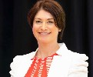
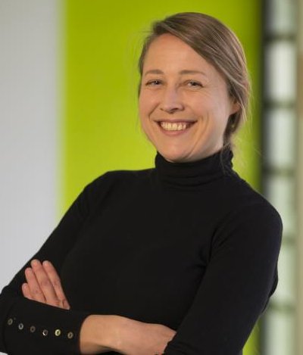
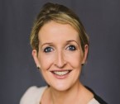
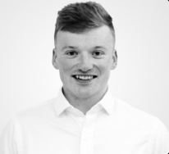
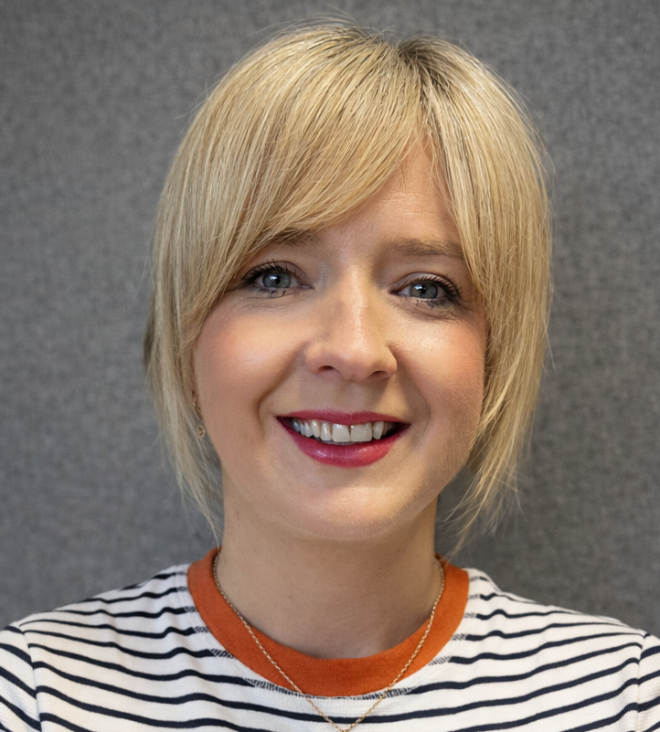
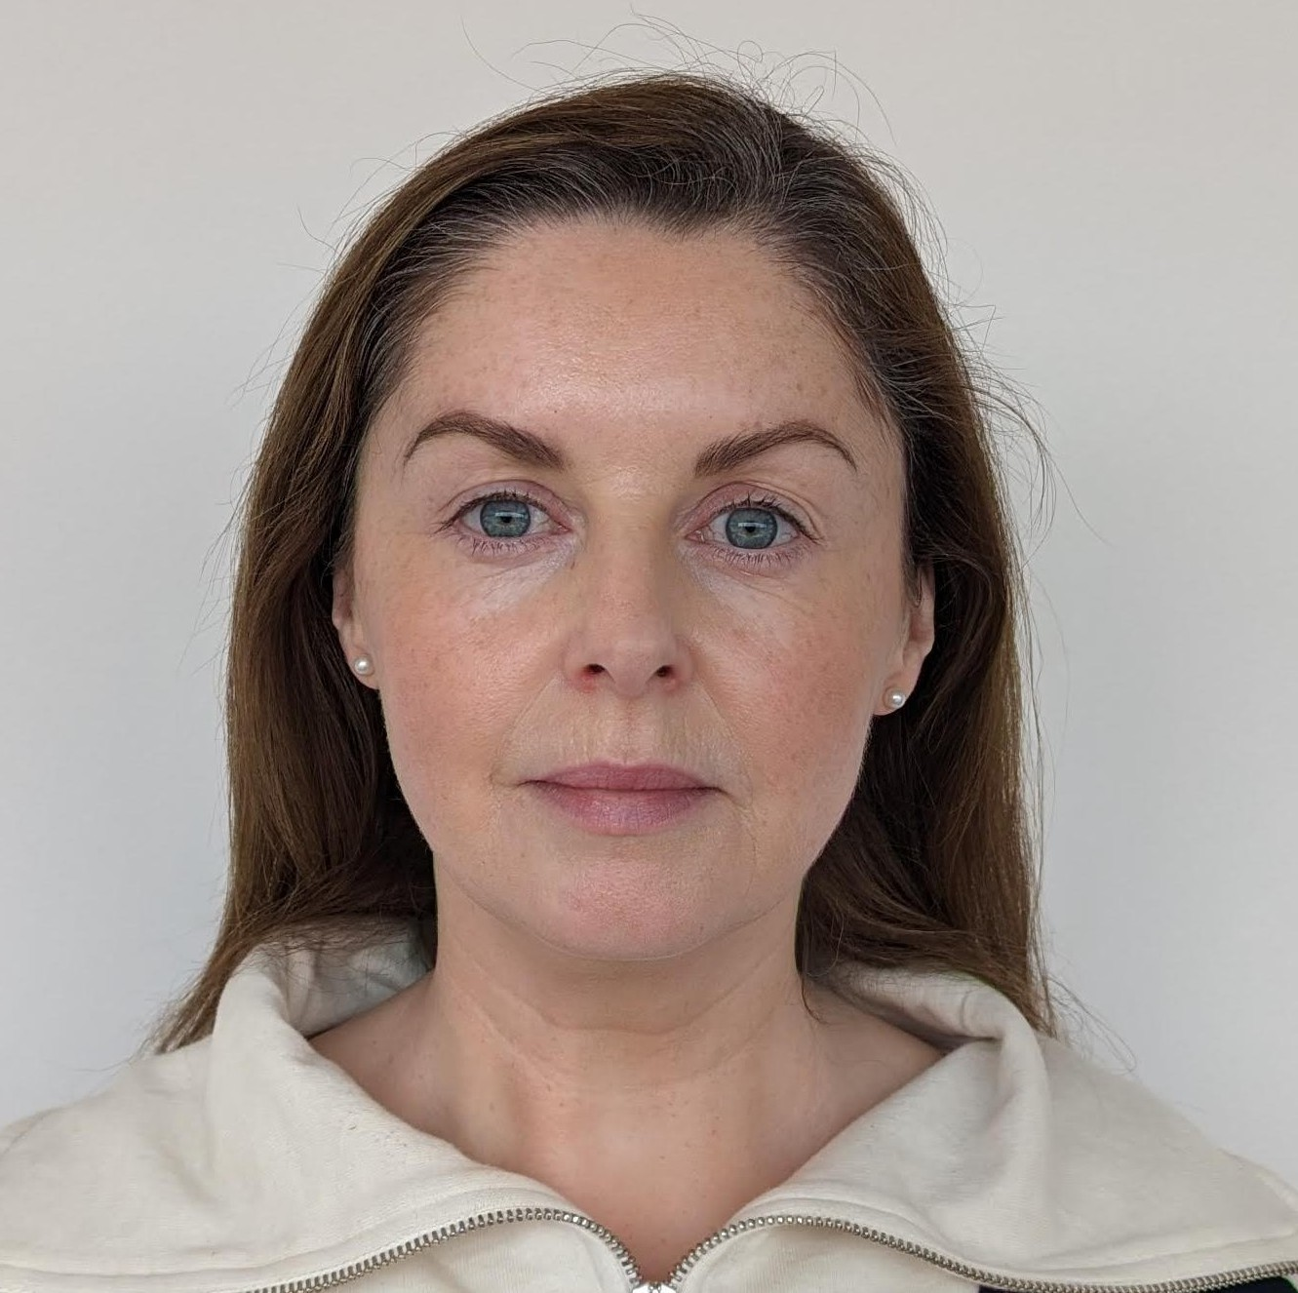
HR Team
Photo | Name | Area of Responsibilities | Email
 | Shauna Whyte | Vice President People, Culture & EDI | vppeoplecultureedi@setu.ie
 | Jane Mahony | HR Manager, Employee Experience & Engagement | jane.mahony@setu.ie
 | Sue Hurley | HR Manager, HR Services & Operations Optimisation | Sue.Hurley@setu.ie
 | Darren Fitzpatrick | HR Manager, Workforce Strategy & Analytics | Darren.Fitzpatrick@setu.ie
 | Máire Prendergast | HR Manager, Employee & Industrial Relations | Maire.Prendergast@setu.ie
 | Pauline Keating | Administrator to the Vice President for People, Culture & EDI | Pauline.Keating@setu.ie

Slide 3
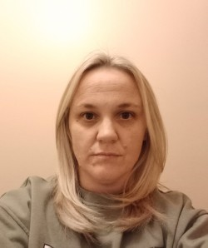

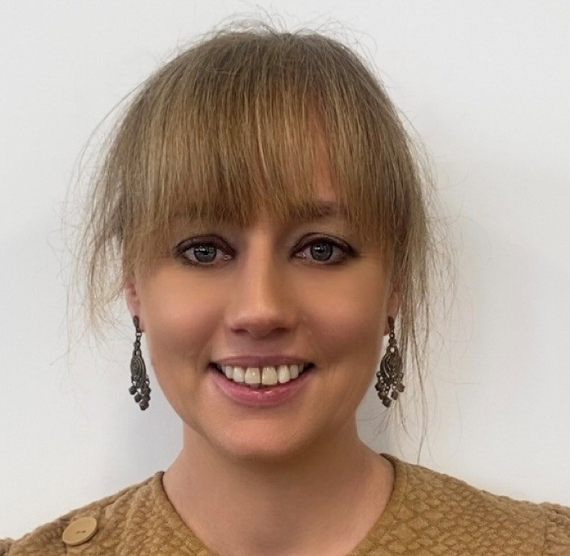
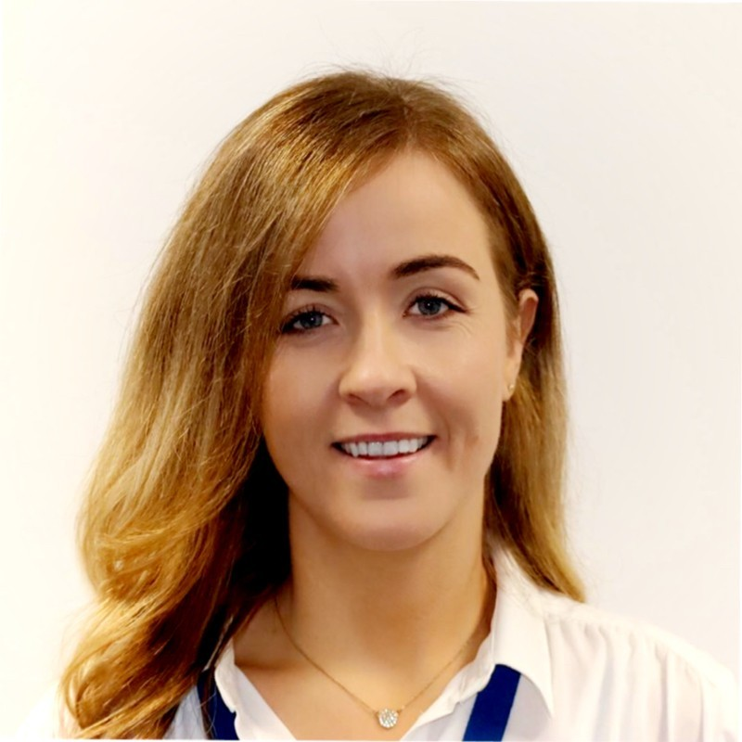
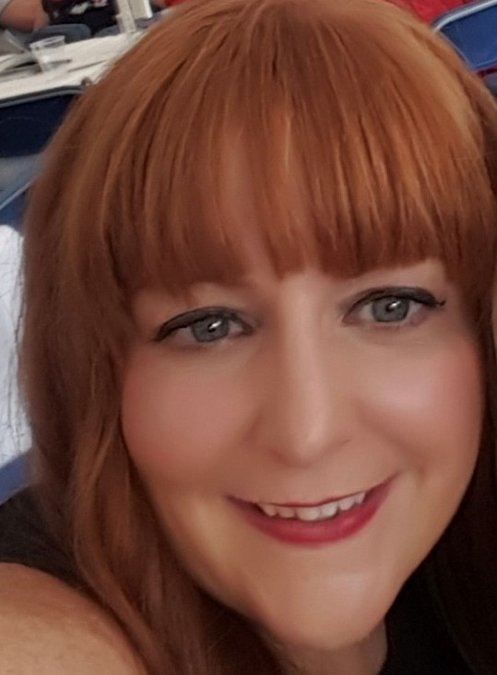
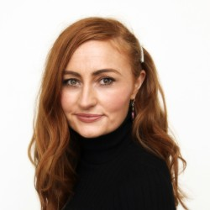
HR People Partners
Photo | Name | Area of Responsibilities | Email
 | Lucy Butler | President Directorate, External Affairs, Governance, Strategy, Information and Communications Technology, Faculty of Health Sciences (WD), Faculty of Science and Computing (WD). | Lucy.Butler@setu.ie
 | Katie J. Murphy | Faculty of Arts & Humanities (CW), Faculty of Business (CW) Faculty of Science & Computing (CW), Global Partnerships, People, Culture & EDI, Finance. | Katie.J.Murphy@setu.ie
 | Jean O Gorman | Wexford Campus, Student Engagement & Success, Faculty of Engineering & Built Env (CW) | Jean.OGorman@setu.ie
 | Robyn Foley | Faculty of Arts & Humanities (WD), Faculty of Engineering & Built Env (WD), Sustainability, Estates & Facilities | Robyn.foley@setu.ie
 | Claire Cashin | Faculty of Business (WD), Faculty of Education & Lifelong Learning, Academic Affairs, Teaching & Learning, Research, Innovation & Impact | Claire.cashin@setu.ie
 | Eimear Fitzpatrick | HR Business Partner for Research- HRS4R Lead (Walton) | Eimear.Fitzpatrick@setu.ie

Slide 4

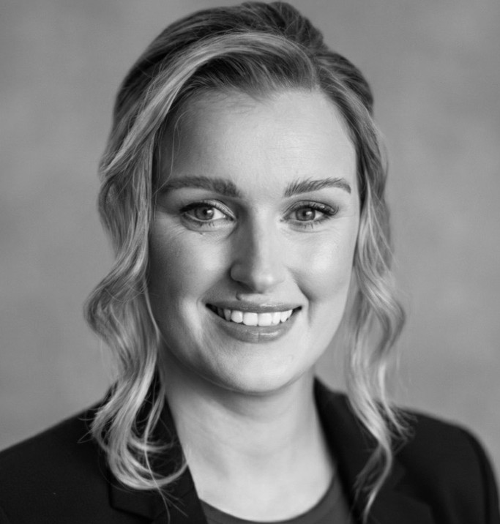
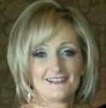
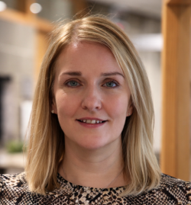
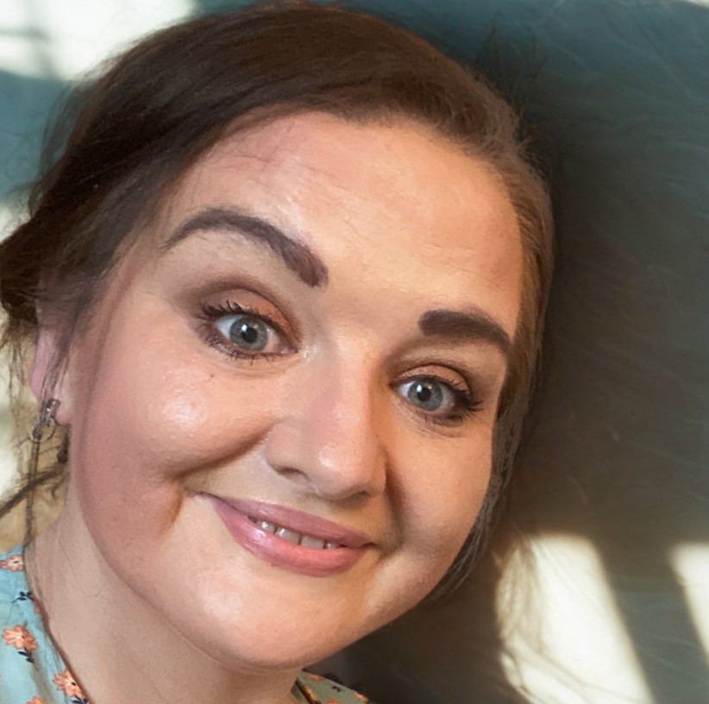
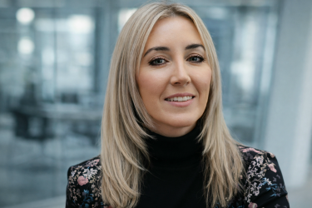
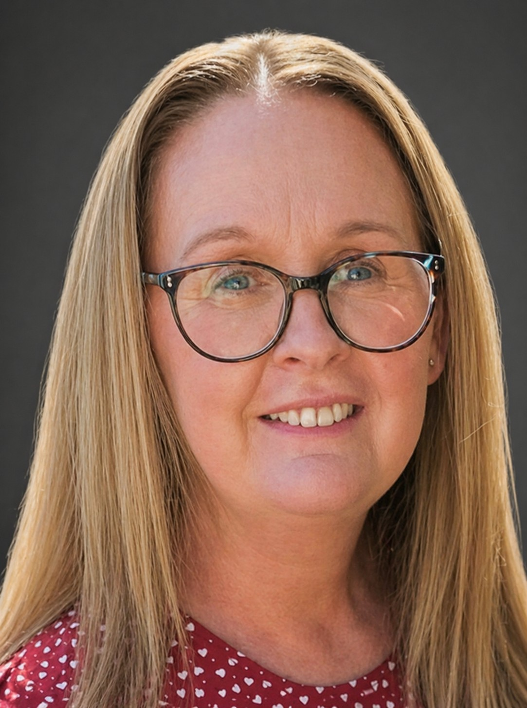
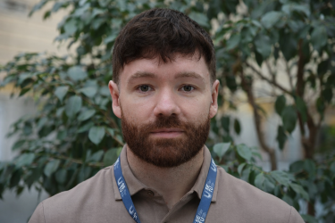
HR Team
Photo | Name | Area of Responsibilities | Email
 | Jamie Power | Recruitment | recruitment.wd@setu.ie
 | Vicky Nolan | Recruitment | recruitment.cw@setu.ie
 | Janet Ayers | Recruitment | turise@setu.ie
 | Jackie Hoban | Recruitment | recruitment.wd@setu.ie
 | Bríd Keogh | Recruitment | recruitment.cw@setu.ie
 | Deirdre O’Sullivan | Recruitment | recruitmentpmss.wd@setu.ie
 | Sarah Jane Doran | Recruitment | recruitment.cw@setu.ie
 | Jamie O’Brien | Recruitment | recruitment.wd@setu.ie

Slide 5

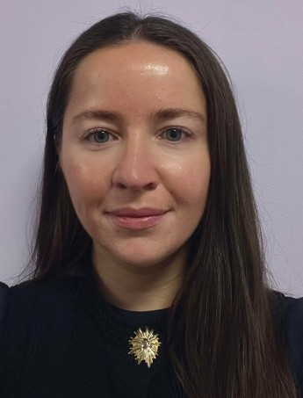
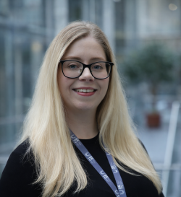
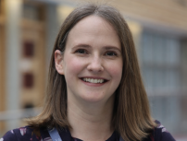

HR Team
Photo | Name | Area of Responsibilities | Email
 | Michelle Kelly | Employee Entitlements | EmployeeEntitlements.CW@setu.ie
 | Grainne Delaney | Employee Entitlements | EmployeeEntitlements.CW@setu.ie
 | Donna Murphy | Employee Entitlements | EmployeeEntitlements.WD@setu.ie
 | Claire Hayes | Employee Entitlements | EmployeeEntitlements.WD@setu.ie
 | Michelle Stacey | Contracts | HRContracts.WD@setu.ie

Slide 6

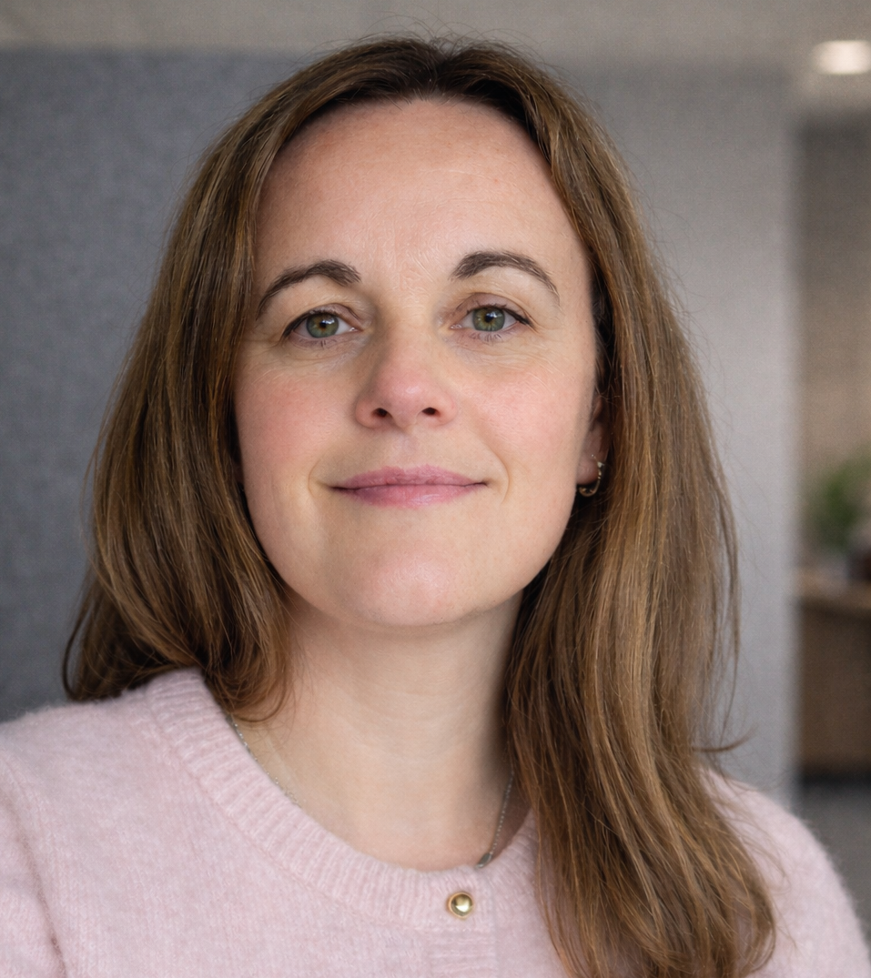
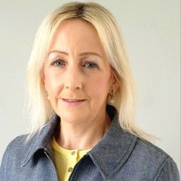
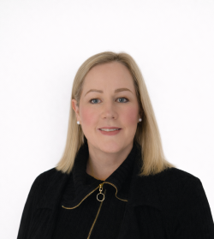
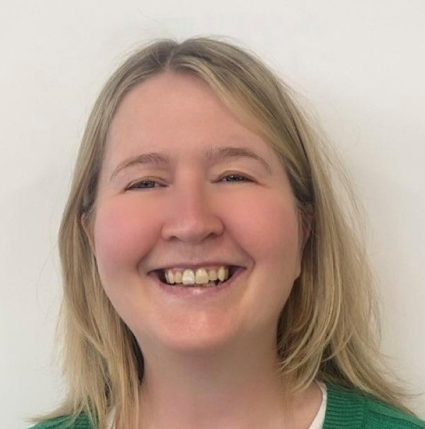
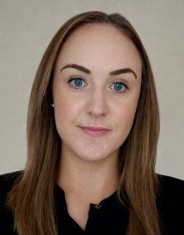
HR Team
Photo | Name | Area of Responsibilities | Email
 | Jackie Branagan | Pensions | Pensions.CW@setu.ie
 | Eimear Kirwan | Pensions | pensions.WD@setu.ie
 | Suzanne King | Pensions | pensions.WD@setu.ie
 | Eimear Flynn | Payroll | HRProfileChange.WD@setu.ie
 | Karen Doyle | Payroll & Contracts | payroll.cw@setu.ie hrcontracts.cw@setu.ie
 | Sarah Stott | Payroll | HRProfileChange.WD@setu.ie

Slide 7
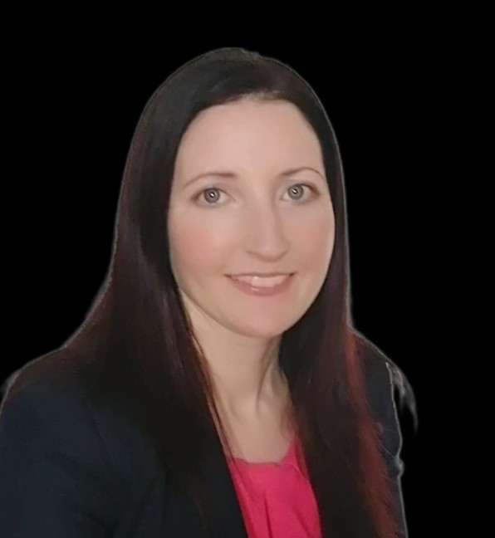
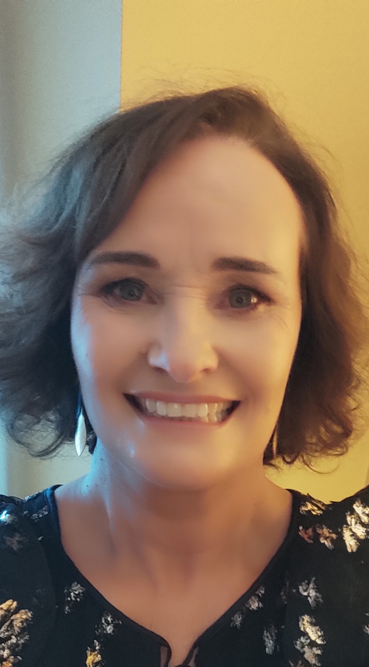
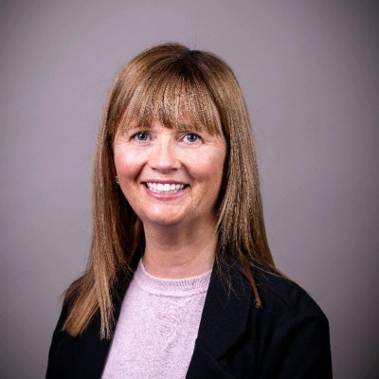
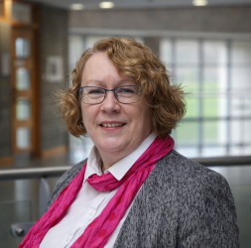
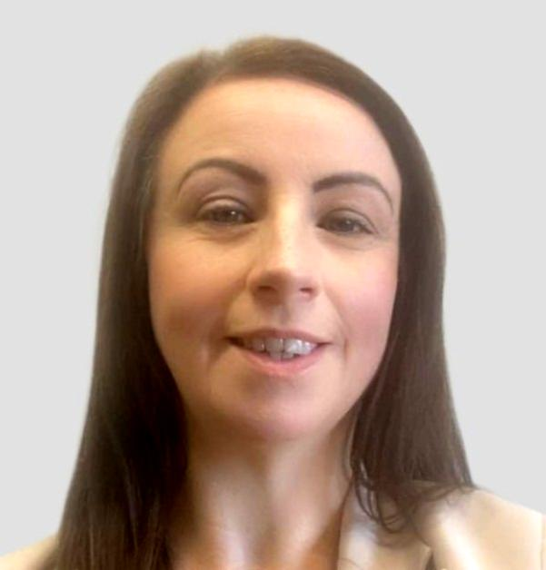
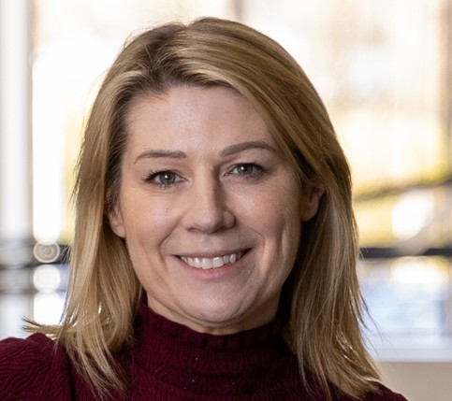
HR Team
Photo | Name | Area of Responsibilities | Email
 | Gráinne McDonald | HRIS | corehr@setu.ie
 | Gráinne O’Meara | HRIS | corehr@setu.ie
 | June Brennan | HRIS | corehr@setu.ie
 | Anne Phelan | HR Business Partner | Anne.Phelan@setu.ie
 | Corina Power | Learning & Development | LearningAndDevelopment@setu.ie
 | Patricia Rochford | Learning & Development | LearningAndDevelopment@setu.ie

Slide 8
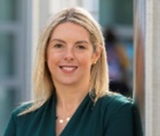
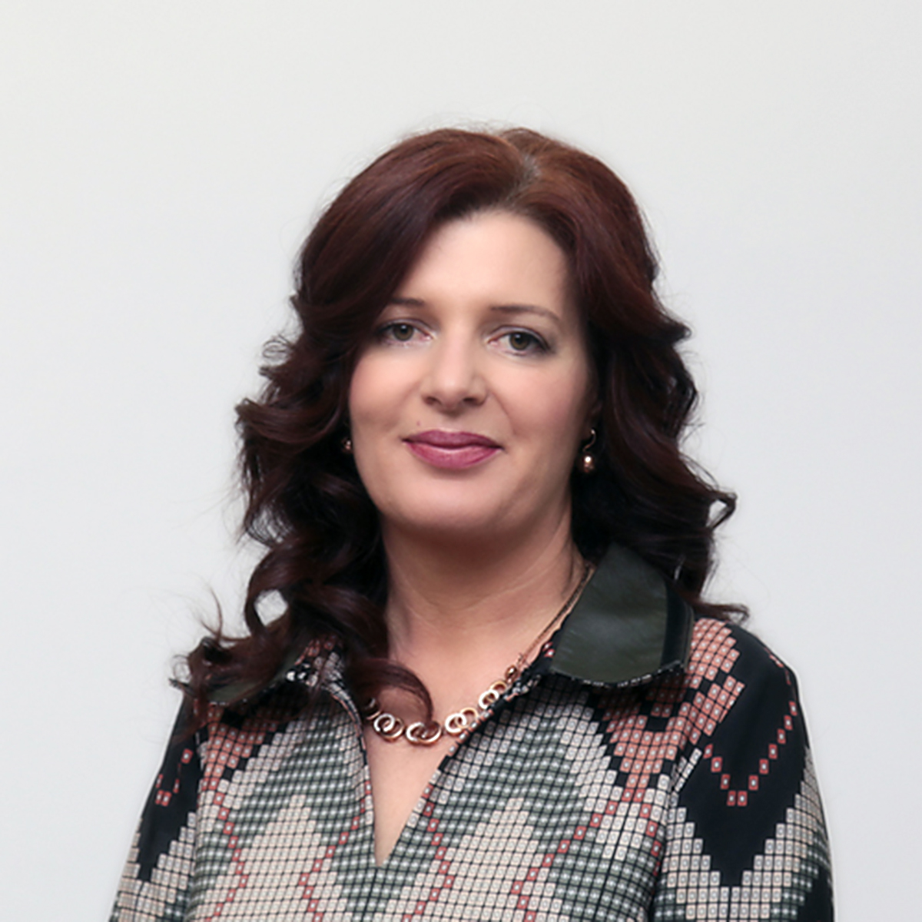
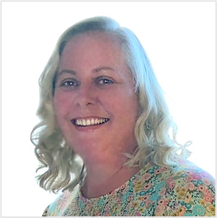
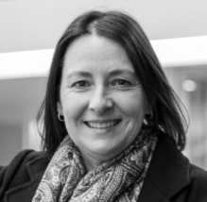

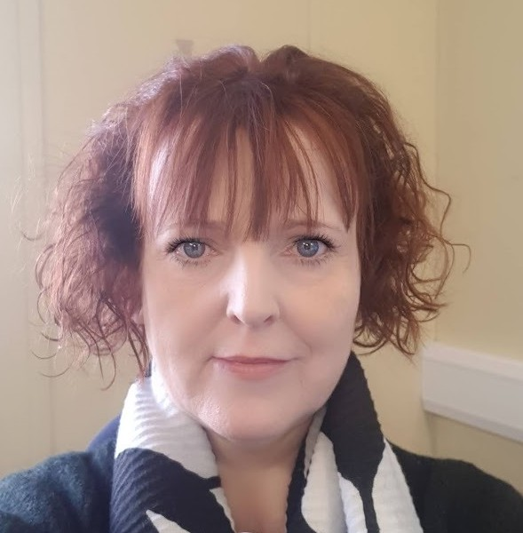

EDI Team
Photo | Name | Area of Responsibilities | Email
 | Allison Kenneally | VP Equality, Diversity & Inclusion | Allison.Kenneally@setu.ie
 | Roisin Shanahan | Tackling SV & HP & Response Manager | Roisin.Shanahan@setu.ie
 | Anne Murphy | Consent Framework Team | Anne.Murphy@setu.ie
 | Ciara Byrne | Consent Framework Team | ciara.byrne@setu.ie
 | Rachel O'Loughlin | EDI Team | Rachel.Oloughlin@setu.ie
 | Samantha O’Connor | EDI Team | Samantha.OConnor@setu.ie
 | Anne Hallinan | EDI Team | Anne.Hallinan@setu.ie

